Slide 1
SC cybersecurity
Databricks Enablement Workshop
Day 3 (Workshop 4)
Ankur Khosla, ankur.khosla@databricks.com
Resident SA, ASEAN
Hao Wang, hao.wang@databricks.com
Specialist SA, Platform/ML, ASEAN
‹#›

Slide 2




Account Team Member Introduction
Prashant Singh
Solutions Architect
Ayushi Kamboj
Sr. Customer Success Engineer
Hao Wang
Specialist Solutions Architect
Hosting workshop 4: Disaster Recovery
Ankur Khosla
Resident Solutions Architect
Hosting workshop 4: Unity Catalog

Slide 3
Day 1 Agenda
Workshop 4 (2 hrs):
1.1 Unity Catalog (60 min)
Architecture
User and Access Management
Automated lineage for all workloads
Data search and discovery
Delta sharing
2.1 Disaster Recovery (50 min)
Definitions - DR, HA
DR strategies with Azure Databricks
Step by step implementation

Slide 4
Housekeeping
Voice out to Accelerate when:
Ask questions during workshop
Too simple / Already know it
Needs deeper content (see appendix first)
Expected Outcome of Workshop 4:
Clear understanding of Databricks Unity Catalog
Know big picture view on Databricks disaster recovery and where to start building elements of DR
Have a clear plan on how to implement DR with your storage, databricks components. Know how to break down DR into actionable modules and start building them

Slide 5
Workshop 4
11:00-13:00
Workshop 4 (2 hrs):
1.1 Unity Catalog (60 min)
Architecture
User and Access Management
Automated lineage for all workloads
Data search and discovery
Delta sharing
Notes:
Tag:azure,aws,gcp

Slide 6
Unity Catalog
Unified governance for data and AI assets

Slide 7
80% of organizations seeking to scale digital business will fail because they do not take a modern approach to data and analytics governance
Source: Gartner

Slide 8




Governance for data and AI is complex
Permissions on files
No row and column level permissions
Inflexible when policies change
Data Lake
Data analyst
Permissions on tables and views
Can be out of sync with data
Metadata
Data engineer
Permissions on tables, columns, rows
Different governance model
Data warehouse
Permissions on ML models, dashboards, features, …
Yet another governance model
Data scientist
ML models, dashboards
Notes:
Talk Track: Data and AI governance today is complex. because of a complex data stack and diverse data teams which need access to data.
In a typical enterprise today, you have lot of data stored in data lakes for example AWS S3.
[Click] To control permissions on data in the data lake, you set permissions on files and directories. [Click] it means you cannot set fine-grained permissions on rows and columns. Because governance controls are at the file level, data teams must carefully structure their data layout to support the desired policies. For example, a team might partition data into different directories by country and give access to each directory to different groups. But what should the team do when governance rules change? If different states inside one country adopt different data regulations, the organization may need to restructure all its data so it becomes complex to rewrite all the policy changes
[Click] With most data lakes, you not only have files but you also have Metadata for example you might have a hive metastore that keeps track of table definitions and views. So you have to give permission on tables and views. [Click] This can actually go out of sync with underlying data. There is no guarantee that if users have access permissions on files, then they will have permission on the corresponding table or vice versa. it becomes very confusing to manage permissions.
[Click] then you might have your data warehouse, where the permissions are more fined-grained on tables, columns and views. [Click] But again it is a different governance model. In typical scenario, you have data movement from your data lakes and data warehouses And now you’ve created data silos with data movement across two systems, each with a different governance model. As a result, your governance method is inconsistent and prone to errors, making it difficult to manage permissions, conduct audits, or discover and share data.
[Click] But data isn't limited to files or tables. You also have assets like dashboards, machine learning models, and notebooks, each with its own permission models, making it difficult to manage access permissions for all these assets consistently.
The problem gets bigger when your data assets exist across multiple clouds with different access management solutions.
[Set the stage for the next slide] What you need is a unified approach to simplifying governance for data and AI.

Slide 9

Databricks Unity Catalog
Unified governance for all data and AI assets
Unity Catalog
Data Lake
Data analyst
Metadata
Data engineer
Data warehouse
Data scientist
ML models, dashboards
Notes:
To address these challenges, we created unity Catalog, which gives a unified governance layer for all data and AI assets in your lakehouse. Unity Catalog provides a single interface to manage permission or auditing for your data and AI assets.

Slide 10





Introducing Unity Catalog
Unified governance for all data and AI assets
Centralized governance for data and AI
Built-in data search and discovery
Performance and scale
Automated lineage for all workloads
Integrated with your existing tools
Lakehouse Platform
Data
Warehousing
Data Engineering
Data Streaming
Data Science
and ML
Unity Catalog Fine-grained governance for data and AI
Delta Lake
Data reliability and performance
Cloud Data Lake
All structured and unstructured data
Notes:
This is where Unity Catalog comes in as the fundamental governance layer for the lakehouse platform.
It provides a unified stance on governance across clouds for all types of workloads.
It helps your organization be compliance and audit ready
It works in a performant manner to meet enterprise scale
It can be seamlessly integrated across your modern stack as it is API first.
Transition - Let’s look at the key capabilities that enable these benefits

Slide 11

Unity Catalog - Key Capabilities
Centralized metadata and user management
Centralized data access controls
Data lineage ^{Private Preview}
Data access auditing
Data search and discovery ^{Private Preview}
Secure data sharing with Delta Sharing
Unity Catalog
Databricks Workspace
Databricks Workspace
GRANT … ON … TO …
REVOKE … ON … FROM …
Catalogs, Databases (schemas), Tables, Views, Storage credentials, External locations
Notes:
So today we’ll discuss these key capabilities of Unity Catalog and some of the broader pattern changes that Unity Catalog as a service and paradigm shift bring to the Databricks ecosystem.
Some of those include:
Centralized metadata and user management
Centralized data access controls
Data lineage ^{Private Preview}
Data access auditing
Data search and discovery ^{Coming Soon}
Secure data sharing with Delta Sharing

Slide 12
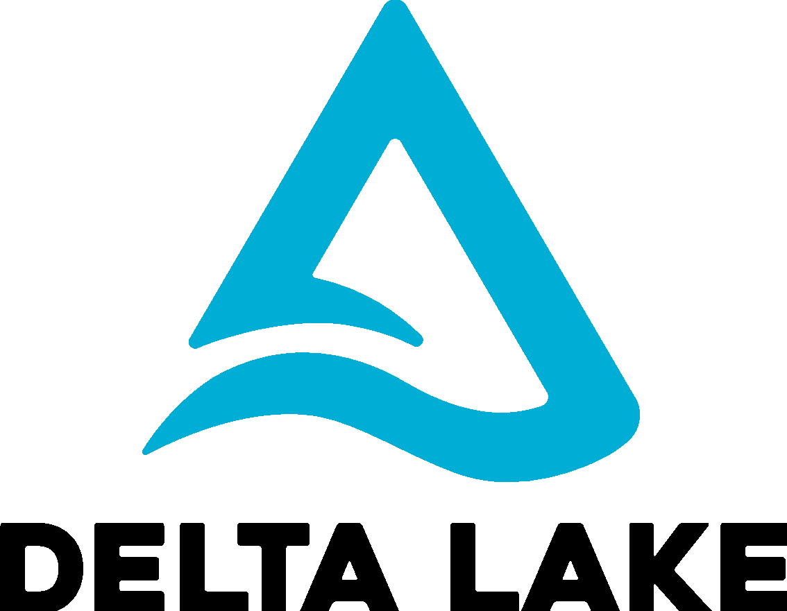


Unity Catalog -Architecture
Audit Log
Metastore
Account Level User Mgmt
Unity Catalog
Lineage Explorer
Storage Credentials
Data Explorer
ACL Store
Access Control
Cloud Storage (S3, ADLS, GCS)
Databricks Workspace
✔
* Container / bucket
User
* Unity Catalog will support any data format (table or raw files)
Notes:
Including the features that I mentioned before, Databricks Unity Catalog represents a paradigm shift in the way we’ve worked with our data prior.
In addition to revamped Data Explorer and a new Lineage Explorer User Interface, Metastores are now available across multiple workspaces, Audit Logs are better defined and work across all compute types, User Management is now an Account level Concern, Storage Credentials are no longer stored at cluster level or on the user principal directly, ACLs in Unity Catalog are stored and available across multiple workspaces. Most importantly though, Access Control now works on R, Scala, Python and SQL on both Clusters, DBSQL and Serverless DBSQL.
While Delta is the recommended data format in the Lakehouse, Unity Catalog will support the ability to govern almost any data format (table or raw files)
Keep in mind that the concept of a metastore as it was in Hive, is different than it is in Unity. In Unity, the metastore is a top level container for objects like Credentials, ACLs, Catalog/Db/Table information, and definitions of external cloud locations like S3 or ADLS accounts or buckets. We’ll get into some of this later as we explain the changes in paradigm that Unity brings.

Slide 13
Centralized Metadata and User Management
Create a unified view of your data estate
Without Unity Catalog
With Unity Catalog
Databricks Workspace 1
Databricks Workspace 2
Unity Catalog
User Management
Metastore
Access Controls
User Management
User Management
Databricks Workspace
Databricks Workspace
Metastore
Metastore
Access Controls
Access Controls
Clusters SQL Endpoints
Clusters SQL Endpoints
Clusters SQL Endpoints
Clusters SQL Endpoints
Notes:
So prior to Unity Catalog, the concept of a workspace was somewhat monolithic. This was for 3 principal reasons
You had to define users and groups at each workspace, either manually or through some SCIM Synchronization with your Federated Identity Platform.
You also by default had a metastore that could only be used with one workspace.
In addition to that, all access controls existed only in the workspace scope and couldn’t be used outside of that workspace without duplication.
At the end of the day, this results in a higher operational overhead and a lack of efficiency, as well as an inconsistent and non centralized view of your data estate and potentially inconsistent controls on your data
With Unity Catalog, we move these 3 concepts out of workspaces, and into a new object that works orthogonally across all workspaces. This object is called an Account. The Account, including the Account Console, which is a user interface to control the Account, lives purely in the control plane, and as such there is NO customer compute associated with these objects and services.
You will typically have one Account per organization (i.e. your entire company) per cloud provider. Now you can setup data, controls, and user management in one place, and use them across multiple workspaces.

Slide 14
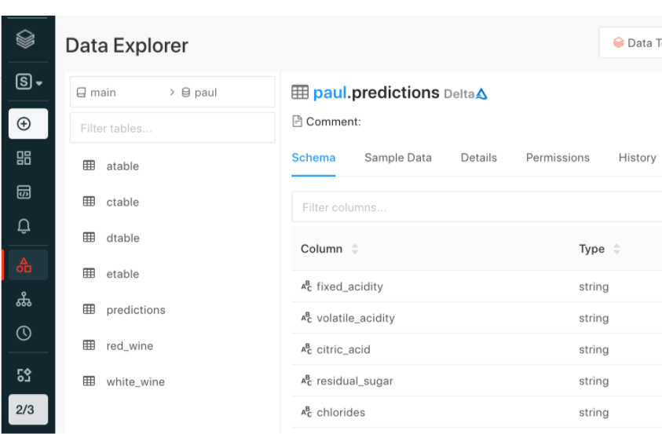
Three level namespace
Seamless access to your existing metastores
Unity Catalog
hive_metastore
(legacy)
Catalog 2
Catalog 1
default (database)
Database 2
Database 1
customers
(table)
External Table
Views
External Tables
Managed Tables
SELECT * FROM main.paul.red_wine; -- <catalog>.<database>.<table>
SELECT * FROM hive_metastore.default.customers;
Notes:
Prior to Unity Catalog, a workspace was effectively a logical point of data segregation.
With Unity Catalog, we needed to add an additional layer of data segregation, so we added a 3rd level of namespacing called a catalog.
A catalog is an object that contains databases, databases like you’re familiar with from Hive and traditional RDBMS’ contain views, and tables.
We also provide the legacy hive metastore in each workspace as a catalog object called “hive_metastore” in Unity Catalog. While this is not strictly part of the catalog, and you cannot write ACLs on this hive metastore that live in Unity Catalog, it allows for you to seamlessly access your old tables, ensuring that as part of your upgrade, your jobs, dashboards, and other query experiences are not impacted. Note, legacy TACLs will still work on the legacy hive metastore on TACL enabled clusters and DBSQL.

Slide 15
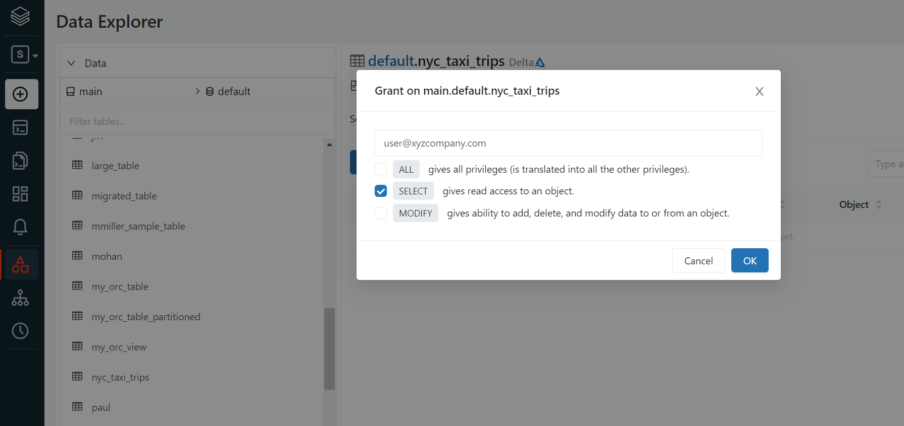
Centralized Access Controls
Centrally grant and manage access permissions across workloads
Using ANSI SQL DCL
Using UI
GRANT <privilege> ON <securable_type> <securable_name> TO `<principal>`
GRANT SELECT ON iot.events TO engineers
Choose permission level
‘Table’= collection of files in S3/ADLS
Sync groups from your identity provider
Notes:
One of the tenants that we embrace as a company, is to make things simple. ANSI SQL DCL, the data control language specification part of ANSI SQL, is a familiar interface for RDBMS users and admins alike. This allows you to grant permission scopes on securable objects like tables or locations to principals like groups, users, or service principals.
The same level of functionality is available via our UI in an easy to use point and click manner, which helps for easy access auditing on the spot.
In addition to that, we offer the ability to set these ACLs on objects via our RESTful APIs, which means that anything, from legacy entitlement request processes to modern dev/sec/ops initiatives can be supported and powered by Unity Catalog.
The interesting thing to note with API and UI based ACL grants, is that they are done outside the context of compute, purely through our control plane APIs.

Slide 16

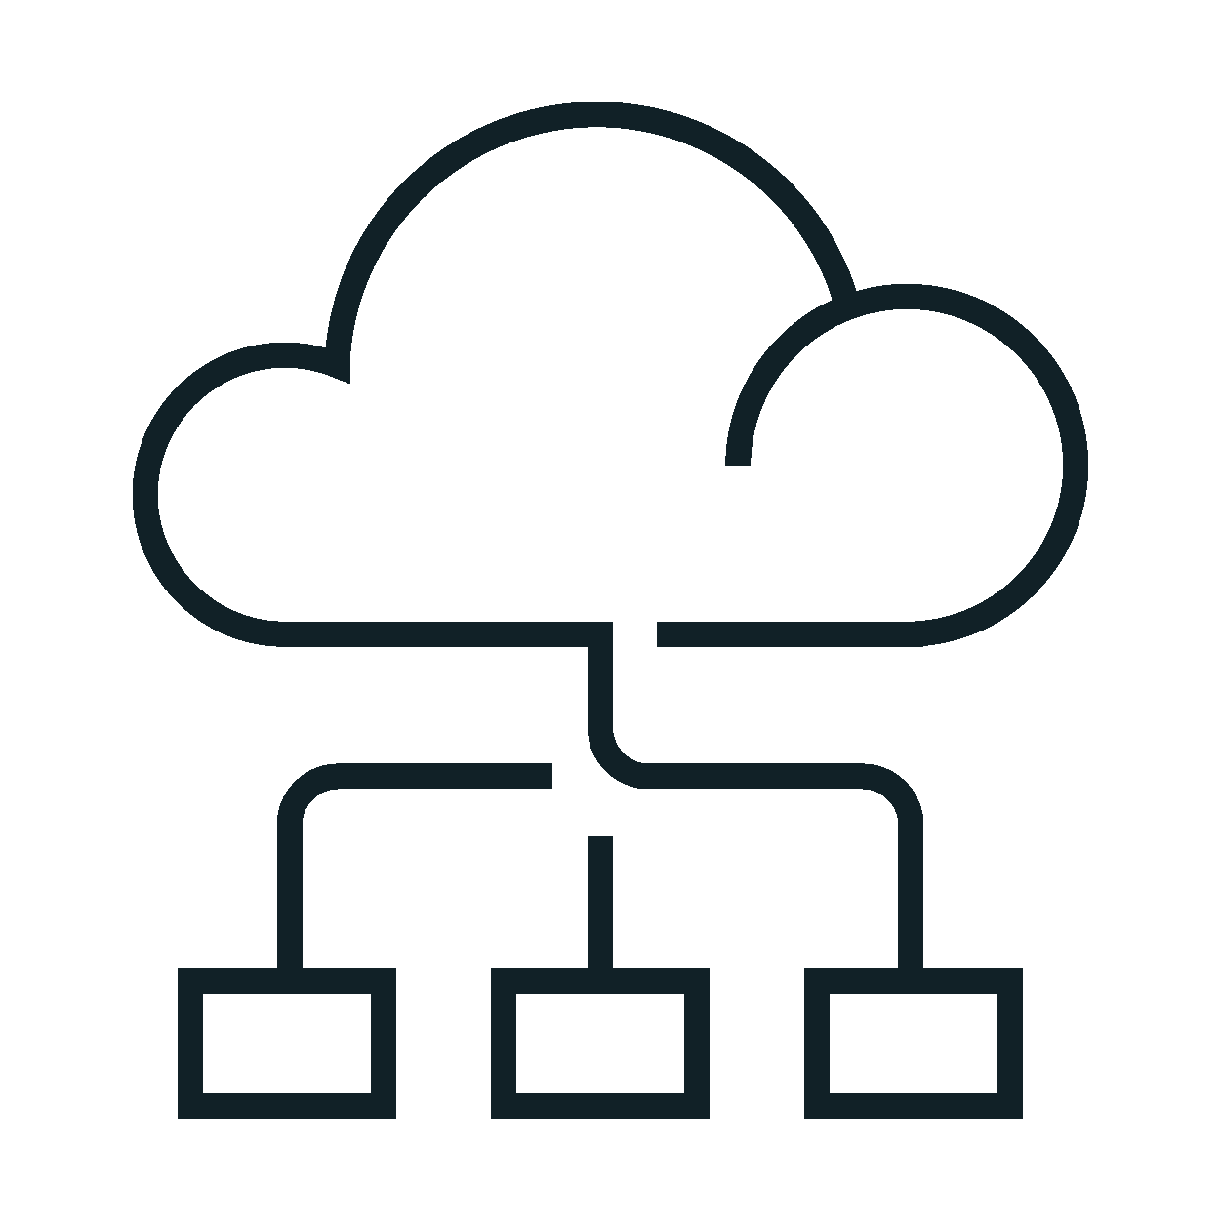

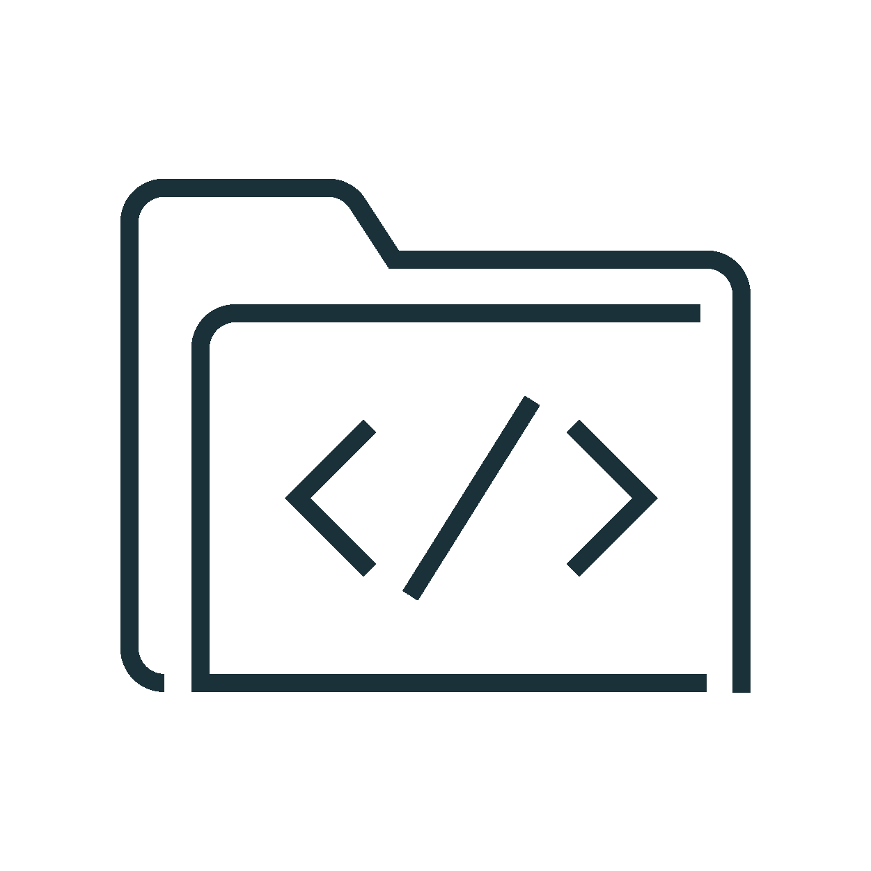
Managed Data Sources & External Locations
Simplify data access management across clouds
Audit log
Unity Catalog
External Locations & Credentials
Access Control
Cloud Storage (S3, ADLS, GCS)
Managed tables
Managed Data Sources
Managed container / bucket
Cluster or SQL endpoint
User
External tables
External container / bucket
…
External Locations
Files in Cloud Strg
External container / bucket
Notes:
Prior to Unity Catalog Credentials to access cloud storage like S3 or ADLS were defined at the cluster or endpoint or in a passthrough mechanism based on the user’s cloud identity.
With Unity Catalog, those Credentials live as first class primitive objects in your Unity metastore. They have ACLs on them like any other object, but they are typically not used by users directly.
When you set up a Unity Catalog Metastore for the first time, you will associate a managed data source with that metastore. This managed data source is a container or bucket that will only be read from and written to via Databricks, through Unity Catalog. Along with this managed datasource is a default credential object that will be used for Unity to broker access to this data. I will explain the request path of how Unity Catalog does this in the next slide.
But to flesh out these concepts, if you create a table in legacy HMS, and you don’t specify a location for that table, it by default will be stored in DBFS. This is known as a managed table in Hive and the default location in Databricks is DBFS.
In Unity, this is very similar, we have a concept of a managed table. that when you create a table without a specified location, it will use the managed data source associated with your metastore to store the table. Managed tables have to be Delta Tables.
There is another first class primitive object within Unity called an External Location. An External Location is a combination of two things, a cloud URL and a Credential. It is an object that can have it’s own ACLs on it and allows users to READ/WRITE or CREATE TABLEs inside it. This is how users can get access to arbitrary files in cloud storage.
If you create a table using a location that belongs to an external location that you have the CREATE TABLE right on, you can now federate this externally defined table to anywhere in your metastore hierarchy. External tables can be delta, parquet, avro, orc, or a number of other supported formats.

Slide 17



Life of a query with Unity Catalog
Creates an IAM role (AWS)/ Managed Identityl (Azure)
Creates storage credentials/ external locations in Unity Catalog
Defines access policies in Unity Catalog
Admin
Check namespace , metadata and grants
2
Write
audit log
Cluster or SQL endpoint
Unity Catalog
Audit log
Send query (SQL
Python, R, Scala,)
Return list of paths/data files and scoped down temporary tokens
User
1
4
Assume IAM Role /
Managed Identity
3
8
Send result
Request/ingest data from paths/data files with temporary tokens
5
Cloud Storage
Enforce policies
7
Return data
(S3, ADLS)
6
Notes:
Let me run you through the life of a query with Unity Catalog
A user submits a query or action, this can be any query/action on any language, Python, R, Scala, SQL. Unity Catalog works across all languages.
This query hits an endpoint or cluster, this can be a standard, user isolation or multi user cluster, a DBSQL Endpoint or a Serverless DBSQL Endpoint, Unity Catalog works across all compute.
The first thing that endpoint or cluster does is hit Unity’s control plane services, to check the namespace, metadata and evaluate the grants for that user.
UC will evaluate whether or not that user has access to read the objects specified in the query or action, a pass or a fail
Depending on that, an appropriate audit log record will be written out.
In the event the user has access, UC will, for each object in the query or action, assume the underlying Credential that controls the external location or managed datasource where that object resides
This could be a Service Principal or an IAM Role
UC will return short lived tokens, roles, or signed URLs to the cluster/endpoint
Short lived is 1 hour
These are presigned urls or downscoped roles in S3 or SAS URLs in ADLS
Keep in mind steps 2,3,4 are control plane activity, so this operation happens in milliseconds
Once the cluster or endpoint has these tokens or presigned urls it will go grab the data files directly from Cloud storage.
UC is not in the path of data.
–
Because UC will grant access to data at the partition level, the last mile of filtering for row level filtering or column level filtering will happen on the cluster or endpoint
Before the information is finally sent back to the user or requestor.

Slide 18
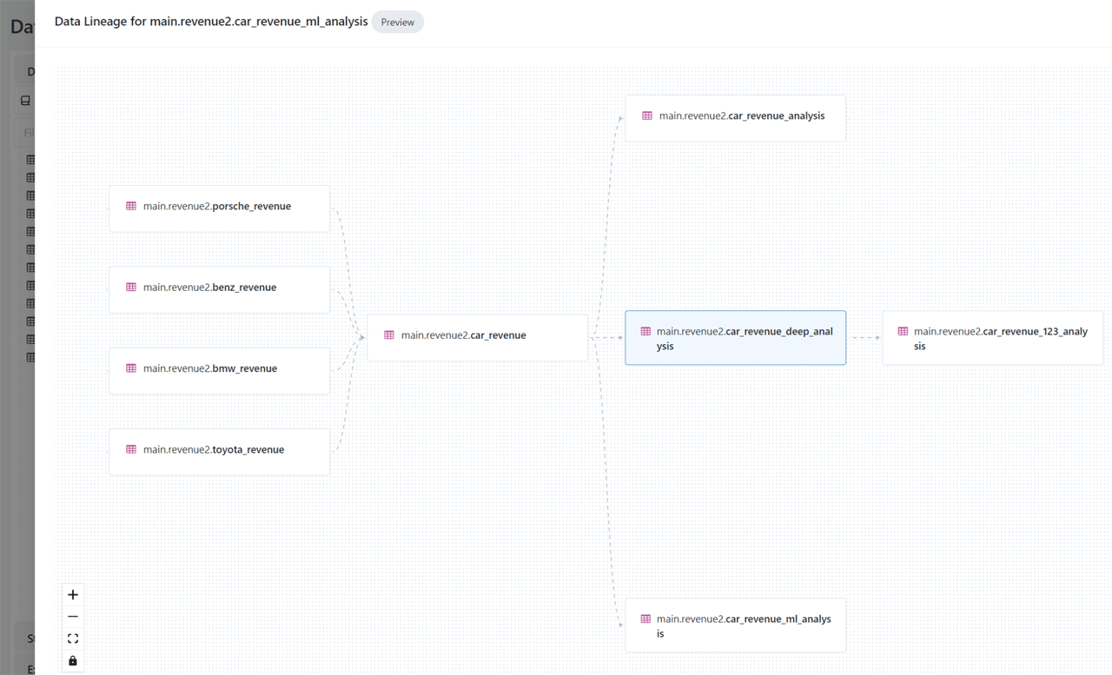
Automated lineage for all workloads
End-to-end visibility into how data flows and consumed in your organization
Auto-capture runtime data lineage on a Databricks cluster or SQL endpoint
Track lineage down to the table and column level
Leverage common permission model from Unity Catalog
Lineage across tables, dashboards, workflows, notebooks
Notes:
So lineage is pretty exciting! We now have the ability to automatically capture runtime lineage on clusters and sql endpoints down to the column level. So that means if you create a derivative data set based on another dataset through the Spark APIs, you will be to see that relationship in an immutable form through our UI and APIs.

Slide 19





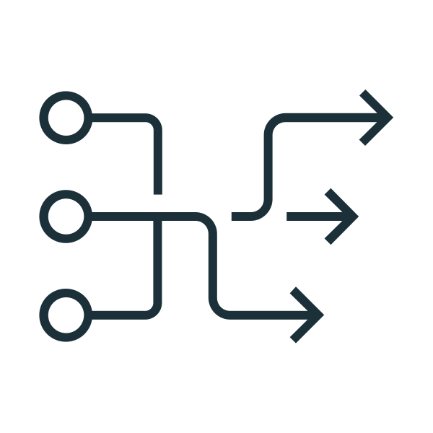

Lineage flow - How it works
ETL / Job
Explore lineage in UI
Workspace cluster / SQL Endpoint
Lineage service
Table and column lineage
Ad-hoc
Alation
*future roadmap
Microsoft Purview
Collibra
DLT
External Catalogs
Code (any language) is submitted to a cluster or SQL endpoint or DLT* executes data flow
Lineage service analyzes logs emitted from the cluster, and pulls metadata from DLT
Assembles column and table level lineage
Presented to the end user graphically in Databricks
Lineage can be exported via API and imported into other tool
Notes:
So let’s talk a bit about how Lineage actually works.
So a user submits a job or code, to a cluster or endpoint, every sql select or spark operation eventually results in sequences of Transformations or Actions, like map or read etc.
Before spark goes off and parallelizes these operations to its worker nodes, it creates something called a LogicalPlan. This is an abstraction of all transformations, in a linked graph form. The metadata of this object get submitted to a lineage service, this runs in the control plane. This service assembles all of these logical plans for all commands together to create lineage graphs that then get boiled down into tabular information about what tables fed into other tables and what columns fed into other columns. This allows you to see things like upstream and downstream consumers of any particular table or column.
This is then exposed to our UI to see that pretty graph you saw on the previous screen and also exposed through our REST APIs to support integrations with Catalog products like Alation, Collibra, and Microsoft Purview.

Slide 20
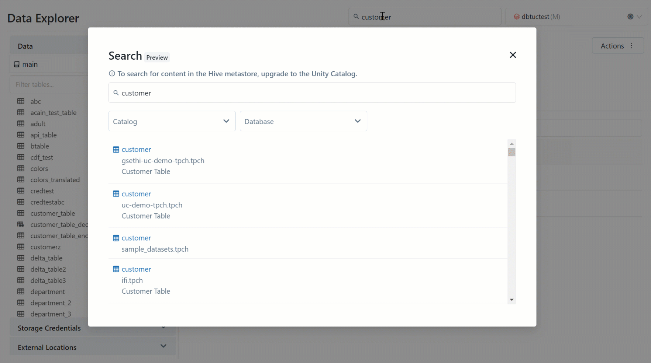
Built-in search and discovery
Accelerate time to value with low latency data discovery
UI to search for data assets stored in Unity Catalog
Unified UI across DSML + DBSQL
Leverage common permission model from Unity Catalog
Notes:
We’ve also introduced Data Discovery, which is an integrated User Interface to discover assets in Unity Catalog. This is a unified UI across personas and it leverages the common permission model from UC, so if you don’t have access to see or read a table, it will not show up in your search results.

Slide 21
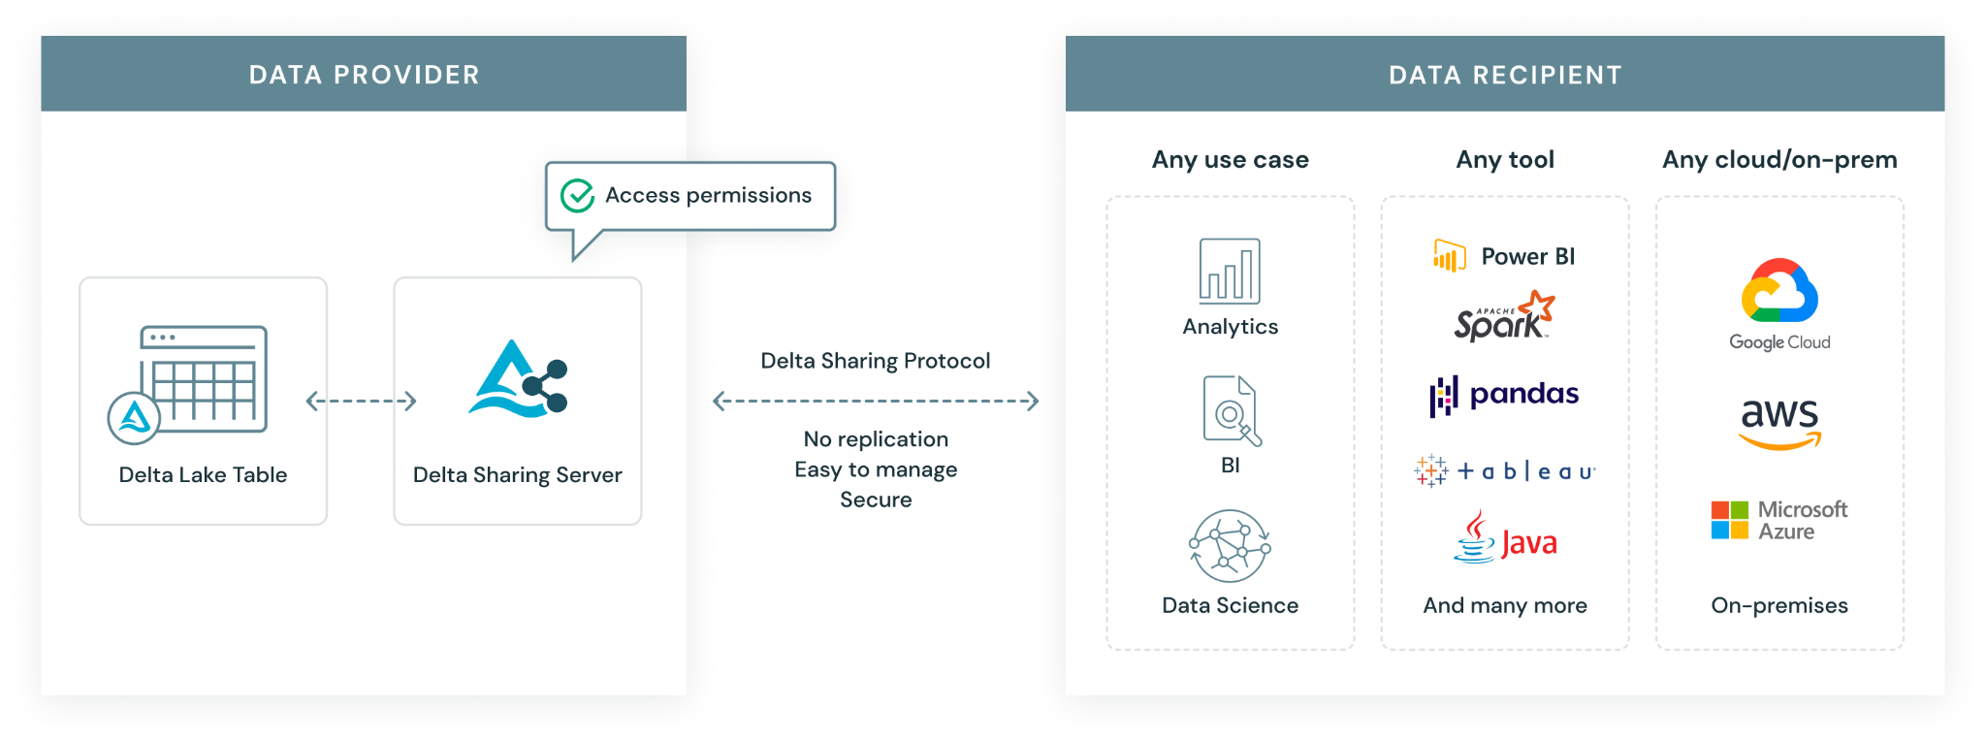
An open standard for secure sharing of data assets
Notes:
The Delta Sharing protocol provides clients a way to…
access data directly where it rests…
The Delta sharing protocol leverages basic concepts and features of the Databricks lakehouse open architecture approach to reduce the friction of sharing data by serving direct access to data, on the cloud where it lives
Open source and plug and play
Delta sharing’s simple REST protocol, and the fact that Databricks has open-sourced a reference Delta sharing server, makes it extremely simple to implement Delta sharing either as a data distributor or data consumer & recipient.
Scaling beyond existing methods of distribution…
Because data is accessed natively on the cloud, where it sits, no streaming or copying of data is required.
Which is integrated into industry analytics tools…
Open source clients (e.g., Pandas, Spark) and commercial clients (Power BI, Databricks and others) support the protocol, offering an alternative to other data sharing approaches which have otherwise strengthened vendor lock-in and platform specificity
tldr:
Delta Sharing is an integral part of Unity Catalog, and the Multi Cloud or Multi Region Story. Delta sharing is used share data inter organizationally, in data sharing use cases, or intra organizationally, to help integrate into open source and commercial clients, or provide a mechanism for organizations to share data across metastores in different regions or clouds.

Slide 22







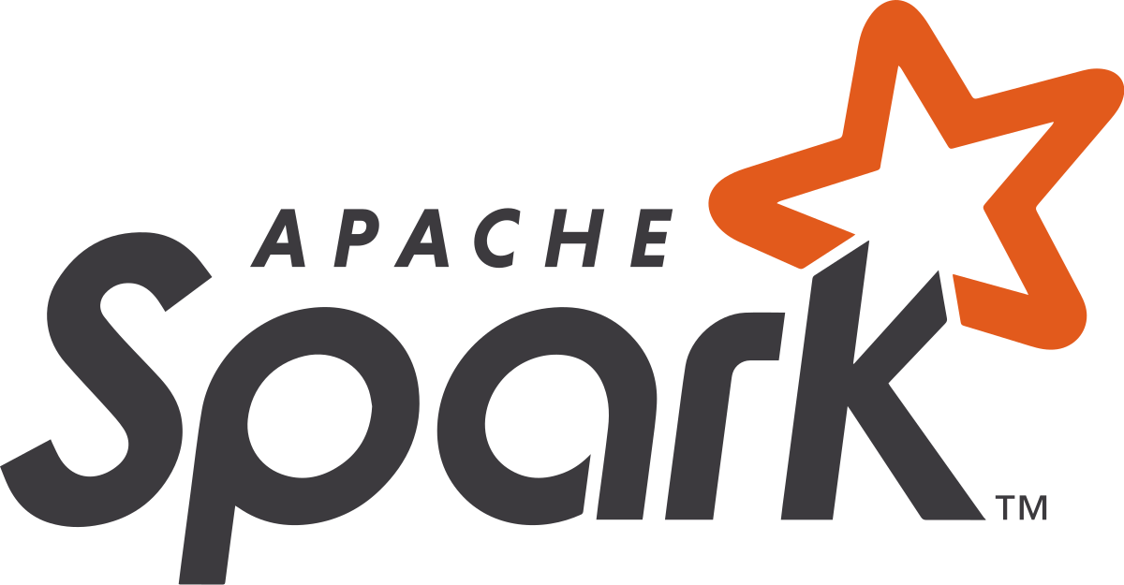


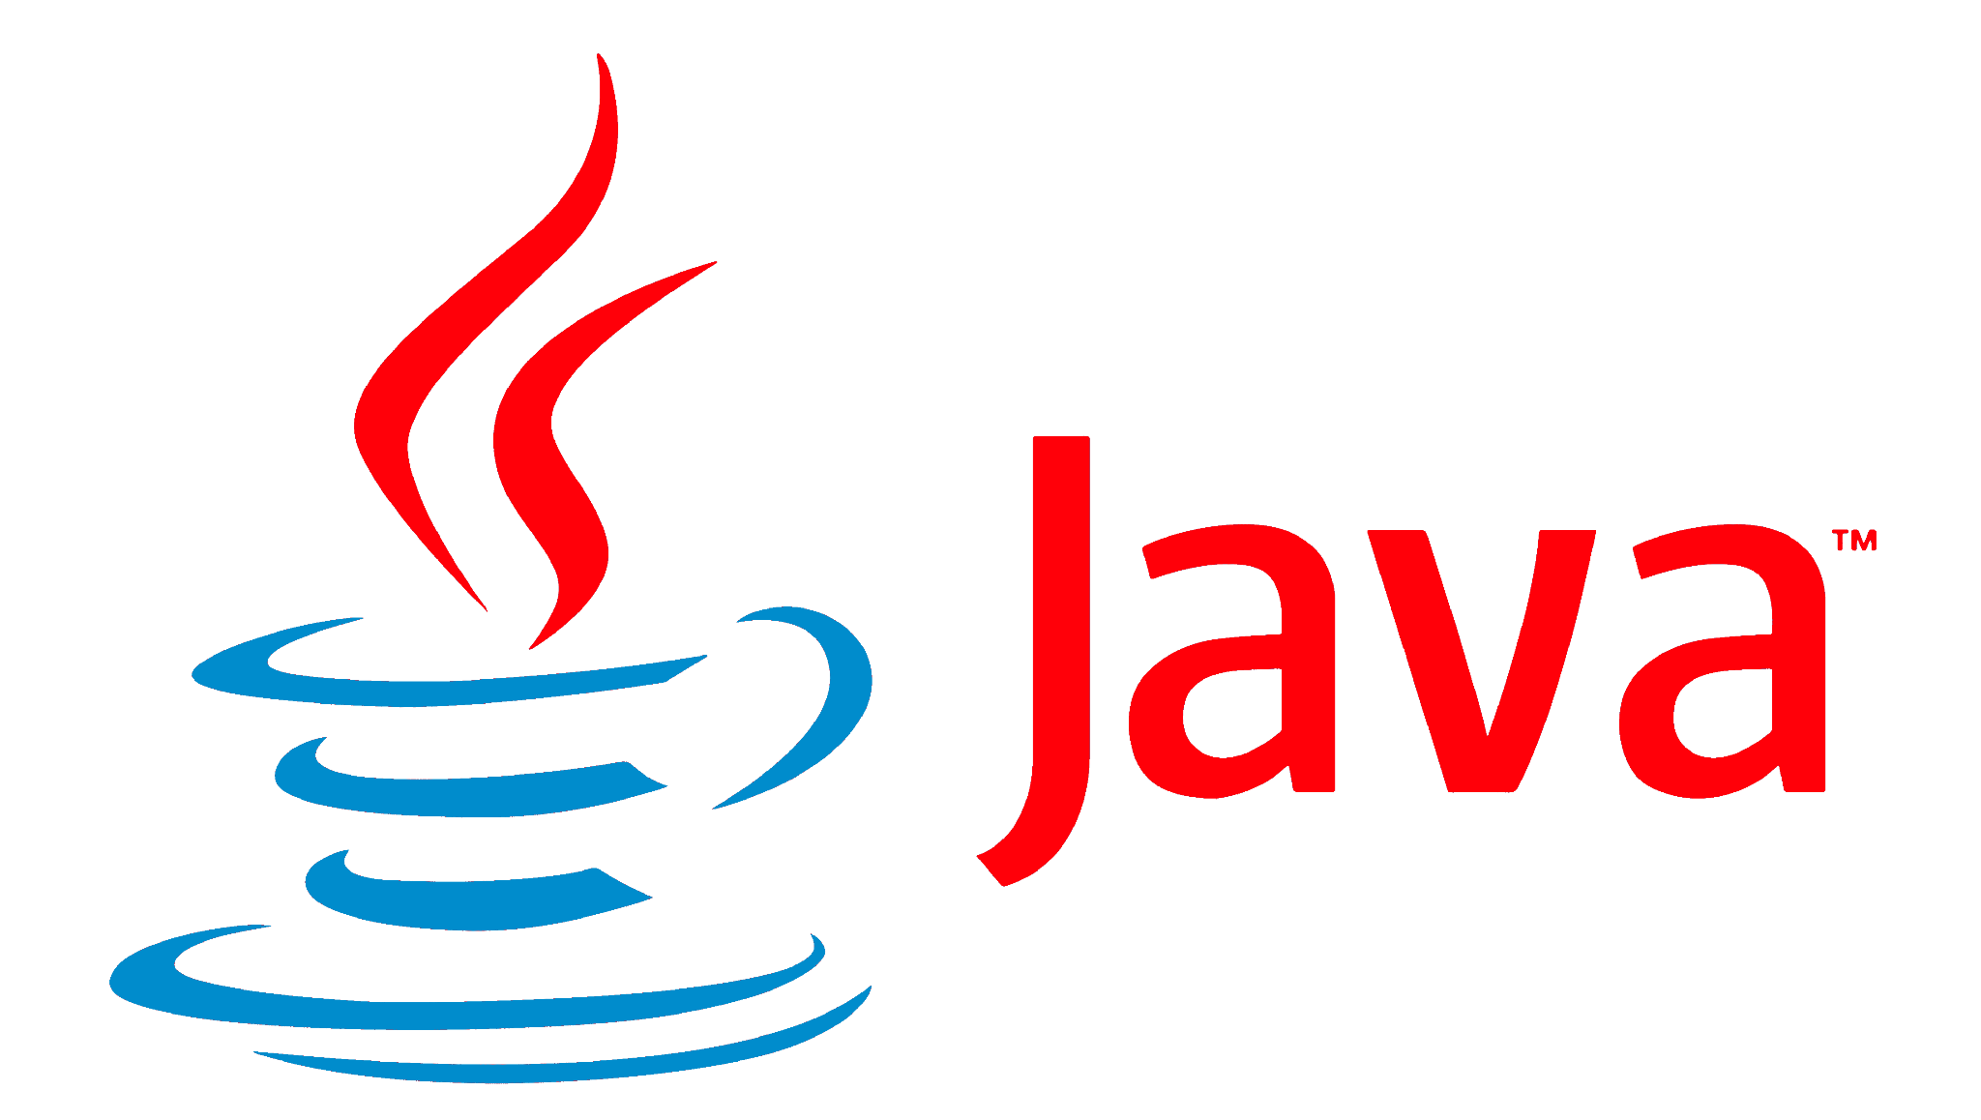
A simple, open and secure approach to data sharing
Accelerate data sharing and collaboration, from days to real-time
Data Provider
Data Recipient
Any use case
Any platform
Any cloud
Authorize Authenticate
Delta Sharing protocol
Analytics
No replication
Easy to manage
Secure
Delta Lake
Delta Sharing Server
BI
On-Premise
Data Science
…
Notes:
Delta Sharing protocol provides clients a way to…
access data directly where it rests…
The Delta sharing protocol leverages basic concepts and features of the Databricks lakehouse open architecture approach to reduce the friction of sharing data by serving direct access to data, on the cloud where it lives
Open source and plug and play
Delta sharing’s simple REST protocol, and the fact that Databricks has open-sourced a reference Delta sharing server, makes it extremely simple to implement Delta sharing either as a data distributor or data consumer & recipient.
Scaling beyond existing methods of distribution…
Because data is accessed natively on the cloud, where it sits, no streaming or copying of data is required.
Which is integrated into industry analytics tools…
Open source clients (e.g., Pandas, Spark) and commercial clients (Power BI, Databricks and others) will support the protocol, offering an alternative to other data sharing approaches which have otherwise strengthened vendor lock-in and platform specificity

Slide 23
What’s coming next
Governance and sharing of machine learning models
Attribute based access controls (ABAC)
Row and column filtering

Slide 24
Part 2:
Disaster
Recovery
2.1 Disaster Recovery (50 min)
Definitions - DR, HA
DR strategies with Azure Databricks
Step by step implementation
Notes:
Tag:azure,aws,gcp

Slide 25
What is Disaster Recovery (DR)
Disaster recovery is the process of preparing for and recovering from a disaster
Disaster Recovery Event:
Unplanned - A break, some core functionality is down, this can be the cloud network, cloud storage or another core service
Planned - A shutdown or planned outage, in this case, you can connect to the system and run a shutdown process
Disaster Recovery Terminologies:
RPO - maximum acceptable data loss
RTO - maximum acceptable downtime
Primary vs. secondary region
Active vs. passive deployment
Failover vs. Failback
Monitoring tool and metrics
Checkpoint replication
Data source/data consumer failover
1
RPO
Recovery Point Objective
RTO
Recovery Time Objective
System operational with data from time point
1
Actual Data Loss
Actual Recovery Period (downtime)
Incident Occurred
Incident Detected
Recovery Invoked
Incident Mitigated
Time
Notes:
For RTO and RPO, lower numbers represent less downtime and data loss. However, lower RTO and RPO cost more in terms of spend on resources and operational complexity. Therefore, you must choose RTO and RPO objectives that provide appropriate value for your workload.
To select the best strategy, you must analyze benefits and risks with the business owner of a workload, as informed by engineering/IT. Determine what RTO and RPO are needed for the workload, and what investment in money, time, and effort you are willing to make.

Slide 26


Disaster Recovery (DR) is not High Availability (HA)
Your disaster recovery strategy requires different approaches than those for availability
Disaster Recovery
High Availability
Designed to handle a larger regional outage for critical systems
Defined in terms of acceptable downtime (RTO) and data loss (RPO)
Needs the setup of a secondary environment
Requires organization specific decisions and solutions
Ensures a minimal level of operational performance
Measured in in terms of consistent uptime or percentage of uptime
Implemented in place
Does not require significant explicit preparation from the Databricks customer

Slide 27




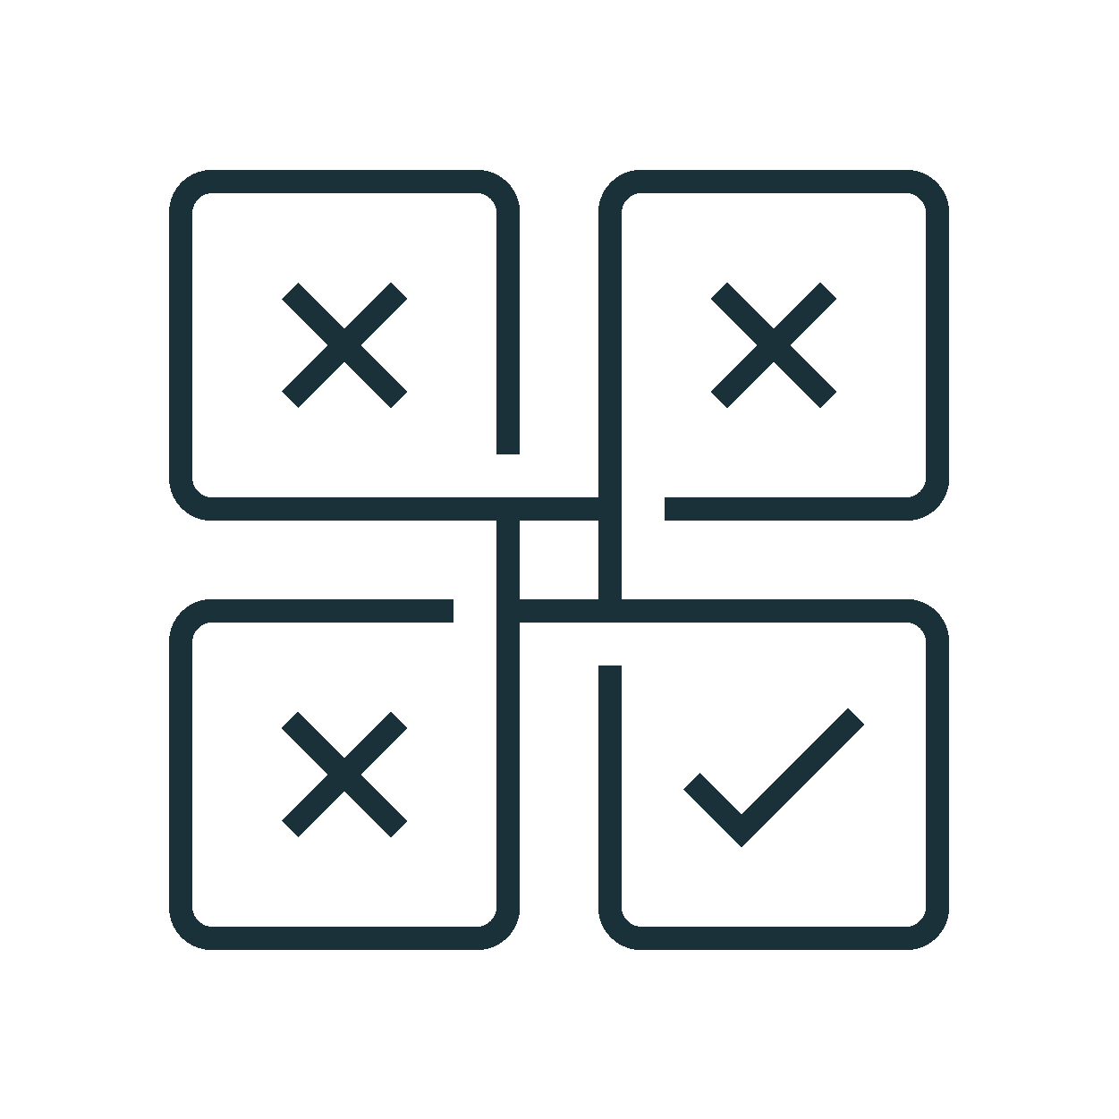


Setup HA/DR on Databricks
A clear disaster recovery plan is critical for a cloud-native data analytics platform such as Databricks
Monitor and detect
Continuous Monitoring and Detection:
Monitoring tool and metrics gathered
Alerting system for notification
Cluster driver logs, Spark UI, Stream metrics, StreamingQueryListener
Understand Your Business Needs:
Identify critical data services
Define an acceptable RPO and RTO
Map all of the Databricks integration points that affect your business
Step 1
Implement and Test your Solution:
Plan for and test changes to configuration tooling
Test failover
Test failback (restore)
Step 5
Step 2
Analysis on how to meet your DR plan:
Assess available tools
Additional support needed
Network configuration modifications
Channels to notify internal teams and third parties
Step 4
Step 3
DR for a Databricks Workspace:
Replicate control plane artifacts (incl. notebooks, code, job config. cluster config., user/group ACLs)
Data replication for batch & streams
Choose a Recovery Solution Strategy:
Active-passive solution strategy
Active-active solution strategy
Choose your tooling (Sync tool vs. CI/CD for parallel deployment)
** Disaster recovery failover and failback can be costly and carries other risks such as data corruption and data duplication
Notes:
Webhook to provide direct API access of status.io page directly to customer datadog/ monitoring solution

Slide 28
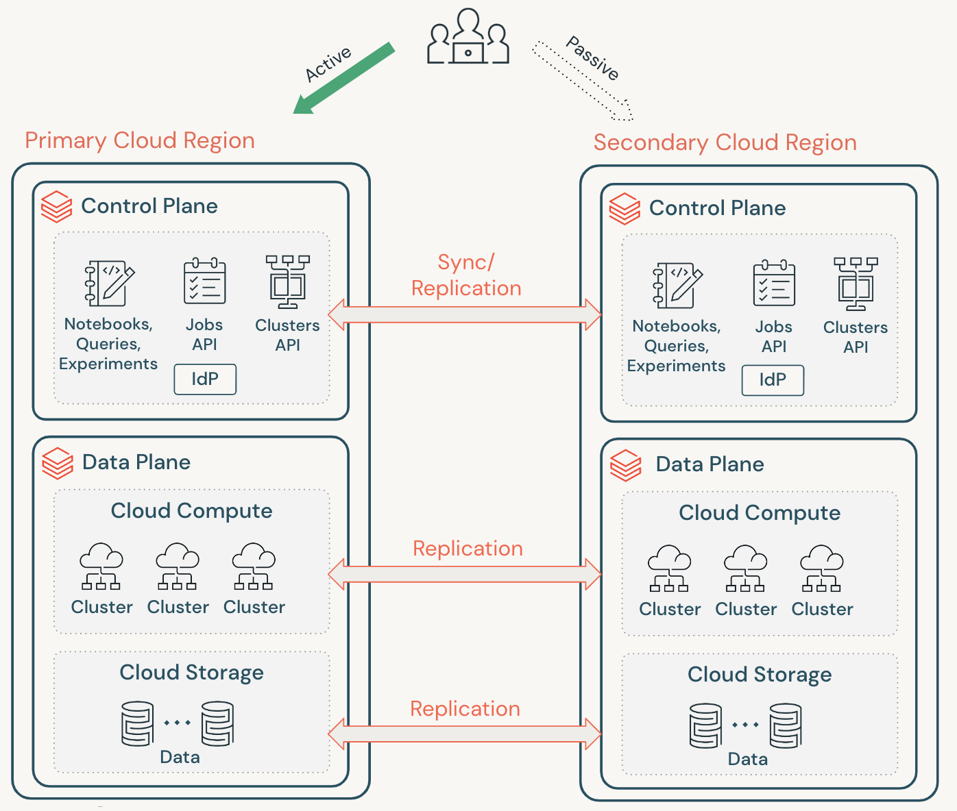
Typical Recovery Workflow
A Databricks disaster recovery scenario typically plays out in the following way:
Failure occurs in primary region
Cannot wait for remediation and secondary region not impacted
Failover to secondary region
Stop activity in primary region, backup recent changes
Recovery procedure in secondary region is initiated
After testing, production workloads are operational
Failback (restore) to your primary region once issue mitigated and resume production workloads
Note
During these steps, some data loss might happen. Your organization must define how much data loss is acceptable and what you can do to mitigate this loss.

Slide 29

Disaster recovery options
Category #1
Backup & Restore
Data and artifacts are saved to the DR site. During a DR event, File-based tables may need to be backfilled and other data sources would need to be restored from the most recent backup
Category #2
Pilot Light
Data stores and databases are up-to-date based on the defined RPO. A workspace and required cloud infrastructure is deployed, but clusters and SQL Endpoints would not be created
Category #3
Warm Standby
Live data stores and databases are maintained, in addition to a minimum live deployment. During a DR event, the DR site must be scaled up to handle all production workloads.
Category #4
Active / Active
Both the primary and DR sites should be fully deployed and operational. In the event of a disaster event, new requests would simply need to be routed to the DR site instead of the primary
Active
Active
Active
Active
Active
Primary Region
Secondary Region
Primary Region
Secondary Region
Primary Region
Secondary Region
Primary Region
Secondary Region
Control Plane
Control Plane
Control Plane
Control Plane
Control Plane
Control Plane
Control Plane
Control Plane
Data Plane
Data Replication
Data Plane
Data Plane
Data Replication
Data Plane
Data Plane
Data Replication
Data Plane
Data Plane
Data Replication
Data Plane
Data Sources
Data Sources
Data Sources
Data Sources
Data Sources
Data Sources
Data Sources
Data Sources
Days
Recovery time
Shorter
$
Cost
$$$$
Notes:
is a secondary site without large capital expenditure
Can scale on demand at the time of an event
Could run as a secondary site of equal scale to on-prem as well

Slide 30
DR Considerations with Databricks

Slide 31
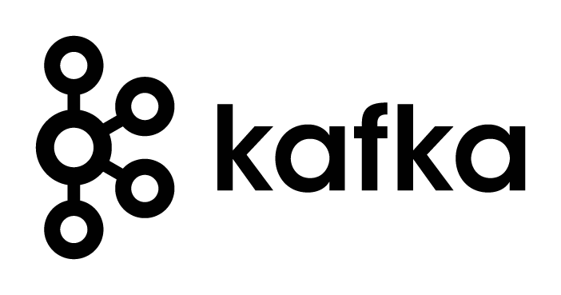


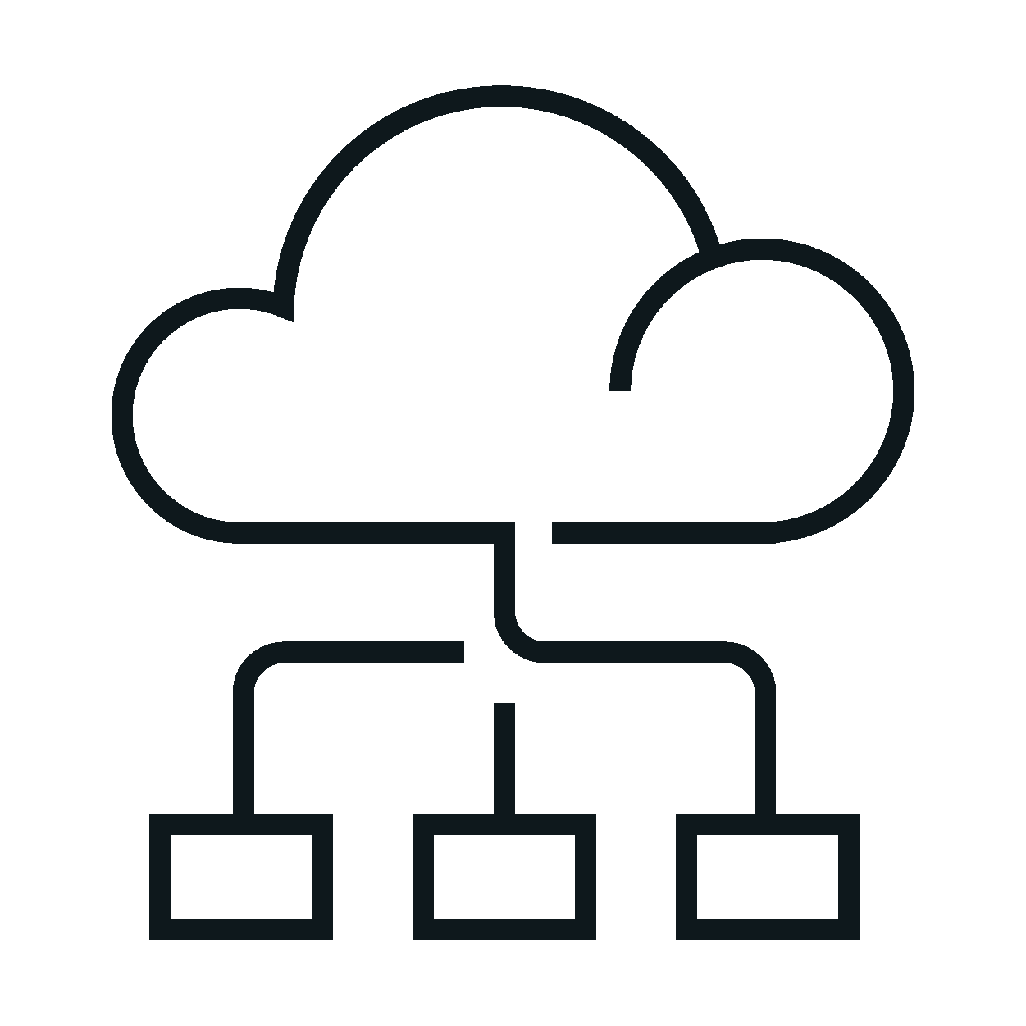

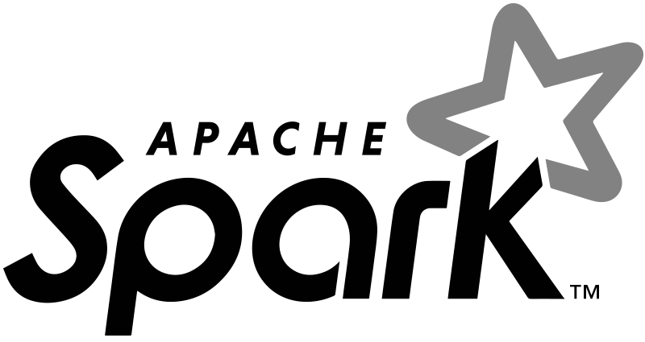

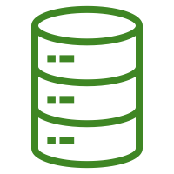
Databricks Architecture
DR solution must replicate the correct data/assets in the control plane, data plane, and data sources
Data
Databricks Cloud Account
Customer Cloud Account
Streaming
Data
Control Plane
Data Plane
Your Cloud Compute
Your Cloud Storage
IdP
API Gateway
Notebooks
Jobs API
Clusters API
Cluster
Cluster
DBFS Root
Batch Data
Metastore, Libraries, Secrets, Experiments
Cluster
Cluster
Data
Files
Data store

Slide 32


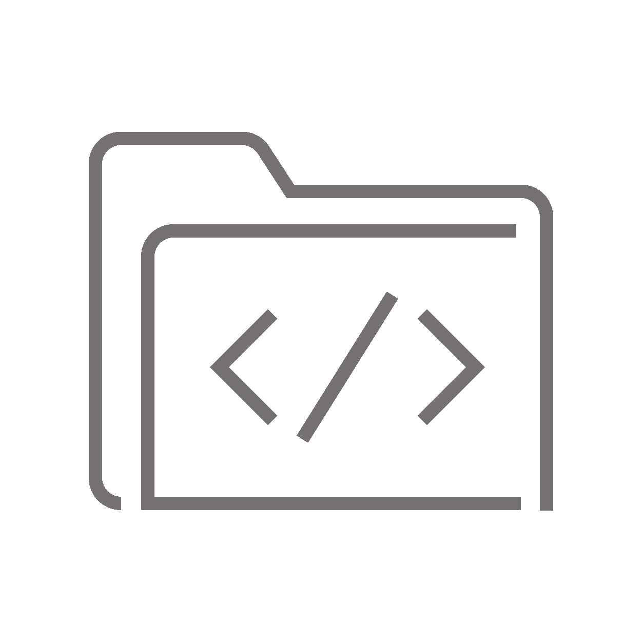
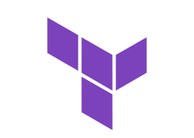






Current DR Setup on Databricks
Active
1
Passive
Use version control (GitHub, GitLab, etc.) to sync TF app and infra code base, job configs, cluster configs using the Repos feature.
Primary Cloud Region
Synchronized Assets
Secondary Cloud Region¹
Control Plane
Git Provider
Control Plane
Codebase
Job configs (JSON)
Cluster
configs
(JSON)
2
Sync
Sync
During a DR event use Terraform Cloud to trigger TF runs (plan and apply) for infra and app pipelines while maintaining state
Notebooks,
Queries,
Experiments
Jobs API
Clusters
API
Notebooks,
Queries,
Experiments
Jobs API
Clusters
API
Terraform Cloud
IdP
IdP
TF Modules
3
Data Plane
Sync
Sync
Data Plane
Identity Provider
For unity catalog, enable ADLS Cross-region replication for backups of metadata. For external hive metastore use Azure SQL DB in multi-region /multi-az deployment.
Cloud Compute
Cloud Compute
Identity
Sync
Ext. Hive Metastore
Sync
Cluster
Cluster
Cluster
Cluster
Cluster
Cluster
Table Definitions
Table ACLs
4
Cloud Storage
Cloud Storage
Cloud Data Plane
Store data in delta format and use dedicated sync jobs to do delta deep clones to secondary regions.
Data
Sync
Sync
Data
GRR/Delta Clones
1: In case of tight RPO and RTO requirements, adopt an Active/Passive Warm Standby approach for the Secondary region, that maintains live data stores and databases, in addition to a minimum live deployment

Slide 33
Control Plane DR Considerations
DR Summary
DR Component: Control Plane |  | DR Tool: Terraform, DB REST APIs, DB CLI | DR Strategy: Synchronize control plane assets such as notebook source code, job configuration, cluster management and user/group ACL data, infra using remote git repo and TF Cloud
Sub-components: Clusters, Jobs, Notebooks, Libraries, DBFS files, Secrets, DBSQL queries, MLFlow experiments
Architecture Diagram
Active
Passive
DR Capabilities
Azure Region Pair | East US to Central US (control plane scc must be different)
Protection Method | All infrastructure and Databricks objects within the scope of the DR solution should be defined as code. For any resource that is not already managed by TF, this is a one-time activity. Use the Databricks Terraform provider to automate the deployment and management of the Databricks assets. Databricks suggests using Repos to help synchronize user-generated notebooks and workspace files. Internal Hive metastore can be replicated using a custom script for exporting tables and table ACLs to the secondary DR workspaces. External Hive metastore can utilize cloud provider services for e.g., leveraging a multi-az database instance or a cloud-native database, such as Azure SQL Database, to replicate the metastore.
Failover Approach | Stop/disable running jobs, notebooks, clusters and pools so so that if the failed service returns online, the primary region does not start processing new data. Sync JSON for cluster configs and job configs to start relevant pipelines. Find your streaming recovery point based on checkpoints. Sync identities from your identity provider (such as Okta). For any outside tool that uses a URL or domain name for your Databricks workspace, update configurations to account for the new control plane. For example, update URLs for REST APIs and JDBC/ODBC connections.
Failback Approach | Sync changes jobs, notebook, libraries, and other workspace objects in the DR workspaces in the secondary region to Terraform, stop clusters and pools in the secondary region in order to stop generating more data and perform failback
Testing Approach | To test failover, connect to the system and run a shutdown process. Ensure that all jobs are complete and the clusters are terminated. Test Terraform modules by deploying real infrastructure into a sandbox environment, allowing them to be inspected to verify deployed resources. Test to make sure that the workspace and the process can execute successfully and provide the expected results
Security Considerations | Terraform helps with automating some of the security configuration tasks, thus reducing or eliminating manual intervention.
Primary Cloud Region
Synchronized Assets
Secondary Cloud Region
Control Plane
Terraform Cloud
Control Plane
TF Modules
Sync
Git Provider
Sync
Notebooks,
Queries,
Experiments
Jobs API
Clusters
API
Codebase
Job configs (JSON)
Cluster
configs
(JSON)
Notebooks,
Queries,
Experiments
Jobs API
Clusters
API
IdP
Sync
Sync
IdP
Identity Provider
Identity
Recovery Time/Data loss Targets
Recovery Time (RTO) | RTO ~in minutes. This will depend on the DR strategy and implementation that is selected for the workload or use case, generally the data should already be replicated that includes source code, dependencies. Live SQL endpoints and metastore must be configured to meet specific RTOs
Data Loss (RPO) | RPO ~ in minutes. For Databricks objects will be the time difference between the most recent snapshot of an object’s state and the disaster event. System RPO should be determined as the maximum RPO of all objects
Implementation Considerations
Adoption Complexity, Limitations and Challenges, Other Notes
Because testing infrastructure modules are expensive and time-intensive, tests should only be run for changed components with an infrequently scheduled build for the whole suite. Using a custom script for internal Hive metastore couples RPO to the Databricks workspace, i.e., the time difference when those internal metastore tables and table ACLs were last exported and the disaster event. For external metastore RPO will depend on SLAs provided by the cloud provider services
Notes:
The Databricks Terraform provider can automate the deployment and management of the Databricks assets, provision Databricks REST APIs, Databricks CLI, Databricks workspace, and even cloud infrastructure.
Code synchronization
Job synchronization
Data synchronization

Slide 34
Data Plane DR Considerations
DR Summary
Component: Data Sources |  | DR Tool: Deep Clones, Geo-Redundant Replication | DR Strategy: Replicate Delta tables with Deep Clone. Files that cannot be converted to Delta should rely on GRR
Sub-Component: Cloud Object Storage
Architecture Diagram
Active
Passive
DR Capabilities
Azure Region Pair | Example: East US to Central US (for data storage services)
Protection Method | The ACID guarantees of Delta Lake virtually eliminate data corruption risks during failover to and failback from a DR site. Furthermore, a deep clone should be used to replicate all Delta tables, it ensures that the latest version of the Delta table is replicated in its entirety, guarantees file order, and provides additional control over when the replication happens. We encourage all major tables to be stored in delta format; for delta tables, use dedicated jobs (batch scheduled / always running) to do deep clone to secondary region. Delta tables should not rely on native copy activities like GRS by storage account since there’s no guarantee that transaction logs and data can arrive together. Use dedicated job to get more control in your data replication activities. Files that cannot be converted to Delta should rely on az- and region-based Geo-Redundant Replication (GRR) services.
Failover Approach | On failover, disable pools and clusters on the primary region so that if the failed service returns online, the primary region does not start processing new data. Based on last synced data start sync from ADLS backups or Delta clones saved in the Azure backup region/data plane or in ADLS to the failover region
Failback Approach | Disable pools and clusters on the secondary region so it will not start processing new data. Sync any new or modified assets in the secondary workspace back to the primary deployment. Depending on the design of your failover scripts, you might be able to run the same scripts to sync the objects from the secondary (disaster recovery) region to the primary (production) region. Sync any new data updates back to the primary deployment. You can use the audit trails of logs and Delta tables to guarantee no loss of data. Shut down all workloads in the disaster recovery region. Change the jobs and users URL to the primary region. Run tests to confirm that the platform is up to date.
Testing Approach | Test failback in a controlled fashion during a maintenance window to minimize any disruptions form this planned event
Security Considerations | Secure all data at rest and in transit using cloud provider native services
Synchronized Assets
Data Plane
Terraform Cloud
Data Plane
Cloud Compute
TF Modules
Cloud Compute
Sync
Ext. Hive Metastore
Sync
Cluster
Cluster
Cluster
Cluster
Cluster
Cluster
Table Definitions
Table ACLs
Cloud Storage
Cloud Data Plane
Cloud Storage
Data
Sync
Sync
Data
CRR backups/Delta Clones
Recovery Time/Data loss Targets
Recovery Time | RTO ~ minutes
Data Loss | RPO ~ minutes
Implementation Considerations
Adoption Complexity, Limitations and Challenges, Other Notes
External Delta tables saved to ADLS storage are not replicated by default These files should be stored within a different location than Delta files to avoid conflicts from running both GRR and Delta DEEP CLONE For data in an object store, RPO will depend on when it was last replicated using Delta Deep Clone or the SLAs provided by the cloud provider in the case of using Geo-Redundant Storage
Notes:
Geo-redundant bucket, ensure 1 region is down

Slide 35
Future Roadmap

Slide 36


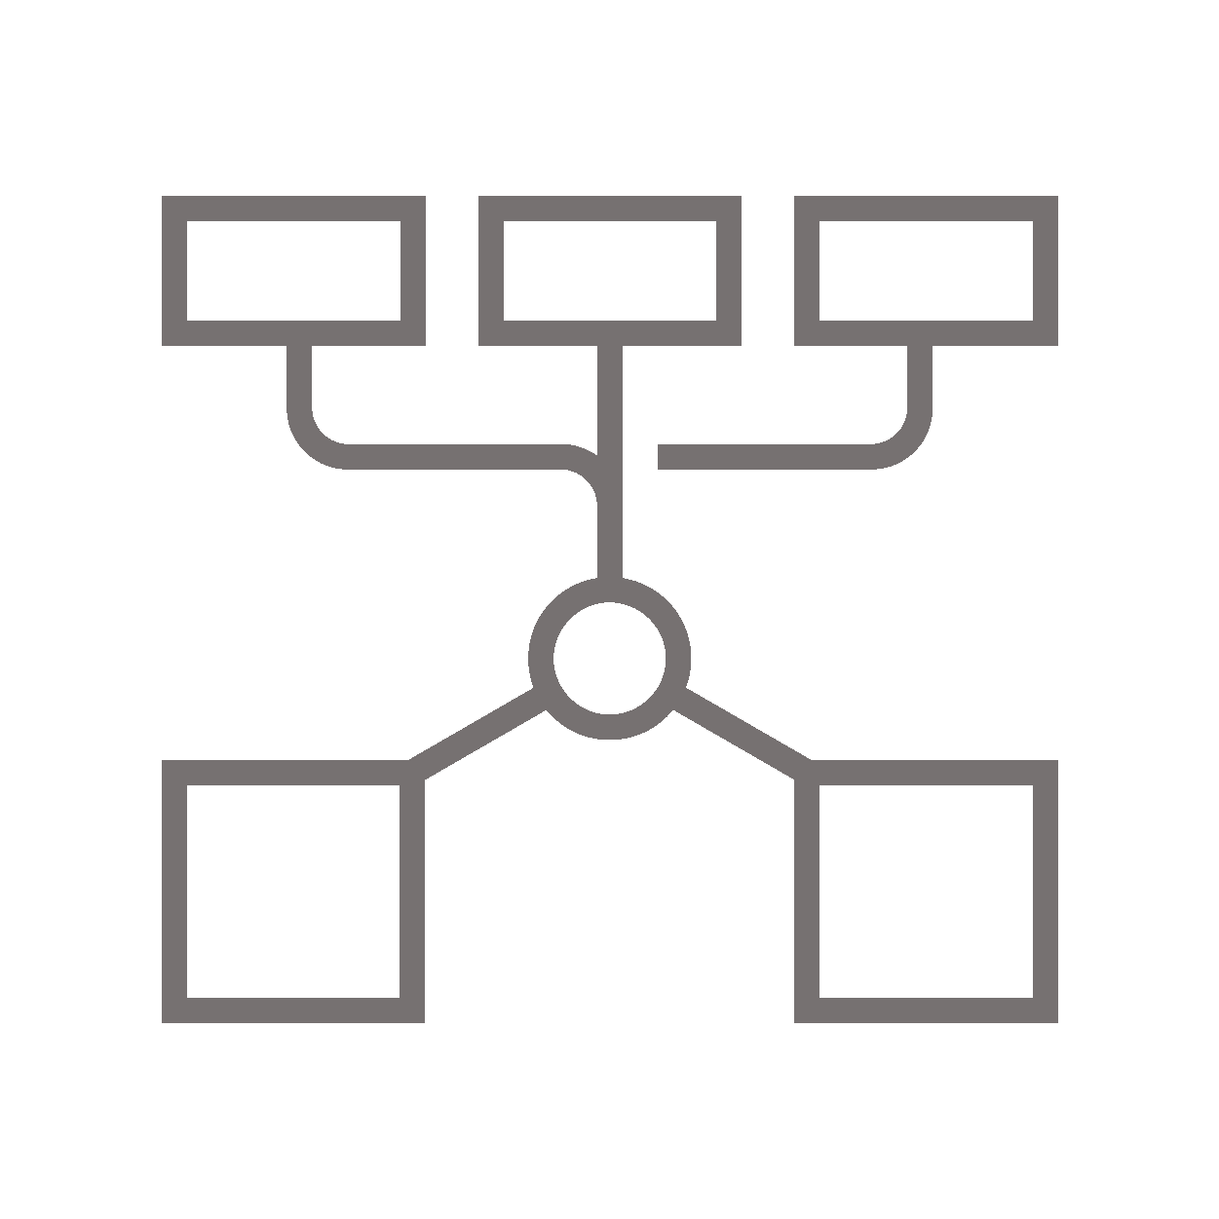
HA - Redundant Control Plane
Phase 1
RTO - mins
RPO - seconds
Includes all CP assets (excl. metastore)
Active
Passive
Primary Cloud Region
Secondary Cloud Region
Control Plane
Redundant Control Plane
Sync
Notebooks,
Queries,
Experiments
Jobs API
Clusters
API
Replicated Job Configs, Cluster Configs, Codebase from active to standby CP
Seamlessly failover to the newly active CP for continued access to customer workspaces
Notebooks,
Queries,
Experiments
Jobs API
Clusters
API
IdP
IdP
Data Plane
Cloud Compute
Cluster
Cluster
Cluster
Cloud Storage
Data

Slide 37
HA - Failover Scenario - Primary CP Failure
Phase 1
RTO - mins
RPO - seconds
Includes all CP assets (excl. metastore)
No Traffic
Active
Primary Cloud Region
Secondary Cloud Region
Control Plane
Redundant Control Plane
Sync
Notebooks,
Queries,
Experiments
Jobs API
Clusters
API
Replicated Job Configs, Cluster Configs, Codebase from active to standby CP
Seamlessly failover to the newly active CP for continued access to customer workspaces
Notebooks,
Queries,
Experiments
Jobs API
Clusters
API
IdP
IdP
Data Plane
Cloud Compute
Cluster
Cluster
Cluster
Cloud Storage
Data

Slide 38
HA - Redundant Control Plane - DR Setup
Phase 1
Active
Passive
Primary Cloud Region
Secondary Cloud Region
Control Plane
Control Plane
Sync
1
For external hive metastore use Cloud database like Azure SQL DB in multi-region /multi-az deployment.
Notebooks,
Queries,
Experiments
Jobs API
Clusters
API
Replicated Job Configs, Cluster Configs, Codebase from active to standby CP
Seamlessly failover to the newly active CP for continued access to customer workspaces
Notebooks,
Queries,
Experiments
Jobs API
Clusters
API
IdP
IdP
Data Plane
2
Synchronized Assets
Store data using delta format; sync primary - secondary storage using delta deep clone; for non-delta sources, use native storage’s sync like GRS
Cloud Compute
Ext. Hive Metastore
Cluster
Cluster
Cluster
Sync
Table Definitions
Table ACLs
Sync
Cloud Storage
Cloud Data Plane
Cloud Storage
Data
Sync
ADLS
Sync
Data

Slide 39
RCP - DR Failover Scenario - Primary Region Failure
Phase 1
No Traffic
Active
Primary Cloud Region
Secondary Cloud Region
Control Plane
Control Plane
Sync
1
For external hive metastore use Cloud database like Azure SQL DB in multi-region /multi-az deployment.
Notebooks,
Queries,
Experiments
Jobs API
Clusters
API
Replicated Job Configs, Cluster Configs, Codebase from active to standby CP
Seamlessly failover to the newly active CP for continued access to customer workspaces
Notebooks,
Queries,
Experiments
Jobs API
Clusters
API
IdP
IdP
Data Plane
Data Plane
2
Synchronized Assets
Store data using delta format; sync primary - secondary storage using delta deep clone; for non-delta sources, use native storage’s sync like GRS
Cloud Compute
Ext. Hive Metastore
Cloud Compute
Cluster
Cluster
Cluster
Sync
Table Definitions
Table ACLs
Sync
Cluster
Cluster
Cluster
Cloud Storage
Cloud Data Plane
Cloud Storage
Data
Sync
ADLS
Sync
Data

Slide 40


Redundant Data Plane or In-Product HA/DR
Phase 2
Active
Passive
Primary Cloud Region
Secondary Cloud Region
Control Plane
Control Plane
Sync
Notebooks,
Libraries,
Experiments
Jobs &
Queries
Cluster
configs
Notebooks,
Libraries,
Experiments
Jobs &
Queries
Cluster
configs
Replicated Job Configs, Cluster Configs, Codebase from active to standby CP
Seamless failover to the newly active CP for continued access to customer workspaces
Data Plane
Data Plane
Cloud Compute
Cloud Compute
Synchronized data plane including clusters
Cluster
Cluster
Cluster
Cluster
Cluster
Cluster
Replication
Cloud Storage
Cloud Storage
Automatic recovery of workloads and data in cloud storage
Data
Data

Slide 41
Multi-Cloud HA/DR
Phase 3
Active
Passive
Primary Cloud Region
Secondary Cloud Region
Control Plane
Control Plane
Replication
Notebooks,
Libraries,
Experiments
Jobs &
Queries
Cluster
configs
Notebooks,
Libraries,
Experiments
Jobs &
Queries
Cluster
configs
Replicated Job Configs, Cluster Configs, Codebase from active to standby CP
Seamless failover to the newly active CP for continued access to customer workspaces
Data Plane
Data Plane
Cloud Compute
Cloud Compute
Synchronized data plane including clusters
Cluster
Cluster
Cluster
Cluster
Cluster
Cluster
Replication
Cloud Storage
Cloud Storage
Automatic recovery of workloads and data in cloud storage
Data
Data

Slide 42
Appendix

Slide 43
General Best Practices
1
Understand which processes are critical to the business and have to run in disaster recovery.
2
Clearly identify which services are involved, which data is being processed, what the data flow is and where it is stored
3
Isolate the services and data as much as possible.
It is the customer’s responsibility to maintain integrity between primary and secondary deployments for other objects that are not stored in the Databricks Control Plane.
4
5
Delta Deep Clone should be used for replication of data to the disaster recovery regions. For non-Delta data sources, it is recommended to use native CSP tools for replication.

Slide 44
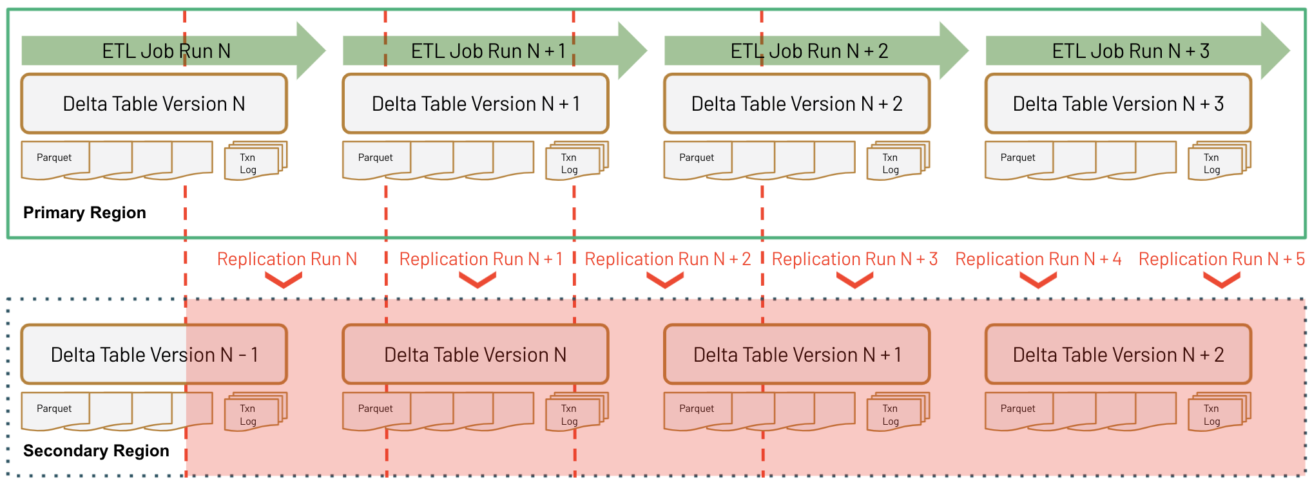
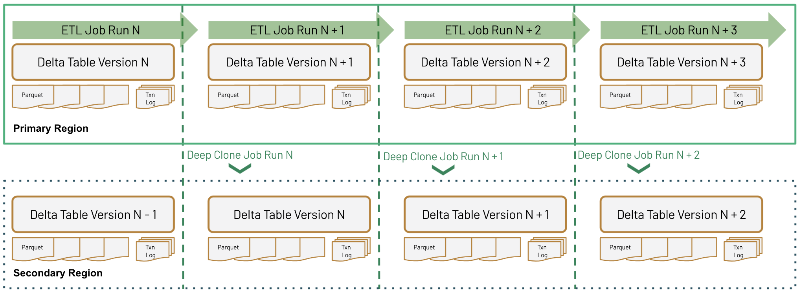
Geo-Redundant Replication vs Deep Clone
Inconsistent data after ETL Job Run N
All Delta files will not arrive in the same Replication Run
Additional effort to ensure data quality
More granular control over replication
Leverages Delta Transaction Log to ensure consistency
Significantly reduce Corruption risks
Notes:
Data consistency guarantees with Delta Clones - https://docs.google.com/presentation/d/1A8feyHfVA9PR3XVwRD6EFpuP3FIUtyv_QTIUnb1ljsw/edit#slide=id.ga000ef721d_5_0

Slide 45
Appendix

Slide 46
Databricks Unity Catalog
Centralized Governance
Audit Log
Identity Provider
Metastore
Account Level User Mgmt
Unity Catalog
Lineage Explorer
Storage Credentials
Data Explorer
ACL Store
Access Control
Cloud Storage (S3, ADLS, GCS)
user
Databricks Workspace
user
✔
Container / bucket
✔
X
user
Databricks Workspace
X
Container / bucket
user
✔
Container / bucket
✔
user
Delta Sharing Client
user
Delta Sharing Server
✔
Short-lived token
X
Access denied

Slide 47
Object relations with Unity Catalog (UC)
Databricks Account Console
Databricks Account
Account Level
User Management
sync users and groups
Identity Provider
has
has
has
has
uses
Databricks Workspace
(Control Plane)
assigned to
(Unity) Metastore
links to and manages
Default Cloud Storage
has
has
has
has
Cluster / SQL Endpoint
External Cloud Storages
has
Recipients
Credential Storage
Catalog Storage
External Locations
links to
Delta
Sharing
read / write
can access
has
Shares
has
catalog.db.table
Hive Metastore
has
Notes:
Using Unity Catalog is optional. Workspaces can still use a Hive Metastore only
There can be more than one Unity Metastore (UC) per Databricks Account (e.g. for regional isolation or for isolation of lines of business)
Every workspace can only attach to one UC Metastore, however one Unity Metastore can be assigned to several Workspaces
‹#›

Slide 48
Unity Catalog and Catalog Partners Better together
Catalog of catalogs (e.g. Collibra, Alation, Purview …)
ETL Tool
Cloud DWH
Domains
Catalog X
Unity Catalog
Catalog Y
E2E Pipeline
Orchestrator (e.g. Airflow)
Lineage information flow:
Pipeline step sending lineage to domain’s catalog (e.g. UC)
Domain’s catalog to global catalog of catalogs

Slide 49


Unity Catalog and Governance Partners Better together
Greatly improves the experience in Immuta and Privacera:
No longer limits the languages that these products can work in
No longer limits the APIs that your users can use
Improves performance and robustness
Adds a common enforcement layer
Policy Specification
Policy Enforcement
Cluster or SQL endpoint
Unity Catalog

